Slide 1
Persebaran Kematian Akibat Kecelakaan
M. Ghozy Al G. – 2110181022
Rissa Hanifah – 2110181028
Dary Winata. – 2110181029

Slide 2
Daftar isi
Kenapa
Tujuan
Alasan mengapa memilih topik
Tujuan yang ingin dicapai
Gambaran
Gambaran umum aplikasi

Slide 3
Persebaran Kematian Akibat Kecelakaan
Permasalahan
Banyaknya angka kematian yang diakibatkan karena kecelakaan setiap tahunnya

Slide 4
Persebaran Kematian Akibat Kecelakaan
Tujuan
Sebagai upaya preventif mencegah terjadinya kematian akibat kecelakaan dengan meningkatkan awareness masyarakat

Slide 5
Persebaran Kematian Akibat Kecelakaan
Gambaran Umum Aplikasi
Aplikasi menampilkan jumlah korban meninggal akibat kecelakaan lalulintas dari setiap negara setiap tahunnya

Slide 6
Internal motivations infographics
Intrinsic motivations
Extrinsic motivations
Mercury is the closest planet to the Sun and the smallest one
Venus has a beautiful name, but also high temperatures
Earth is the third planet from the Sun and the one that has life
Despite being red, Mars is actually a cold place
Jupiter is a gas giant and the biggest planet of them all
Saturn is a gas giant and has several rings
Neptune is the farthest planet from the Sun
The Sun is the star at the center of the Solar System

Slide 7
Internal motivations infographics
Before an activity
During the activity
After the activity
Write what you think before starting here
Write what you think before starting here
Write what you think before starting here
Write what you think before starting here
Write what you think before starting here
Write your intrinsic motivation in here
Write your intrinsic motivation in here
Write your intrinsic motivation in here
Write your intrinsic motivation in here
Write your intrinsic motivation in here
Write your extrinsic motivation in here
Write your extrinsic motivation in here
Write your extrinsic motivation in here
Write your extrinsic motivation in here
Write your extrinsic motivation in here

Slide 8
Internal motivations infographics
Motivations and addiction in work environments
Extrinsic
Intrinsic
Example: Paul wants to excel at his job to have a salary raise
Addiction
Example: Anna enjoys doing her job; it’s not difficult for her at all!
Example: Katrina is very focused on being likable and forgets about herself

Slide 9
Internal motivations infographics
Motivation type | Intrinsic motivation | Extrinsic motivation | Addiction
Motivation source | The source here The source here The source here The source here The source here | The source here The source here The source here The source here The source here | The source here The source here The source here The source here The source here
Motivated behaviour examples | Write an example Write an example Write an example Write an example Write an example | Write an example Write an example Write an example Write an example Write an example | Write an example Write an example Write an example Write an example Write an example

Slide 10
Internal motivations infographics
4 intrinsic motivations that will help your co-workers love their job
Autonomy
Mastery
Despite being red, Mars is a cold place. It's full of iron oxide dust, which gives the planet its red cast
Jupiter is the biggest planet in the Solar System and the fourth-brightest object in the sky
Purpose
Satisfaction
Neptune is the farthest planet from the Sun and the fourth-largest by diameter
Saturn is a gas giant and has several rings. It's composed of hydrogen and helium

Slide 11
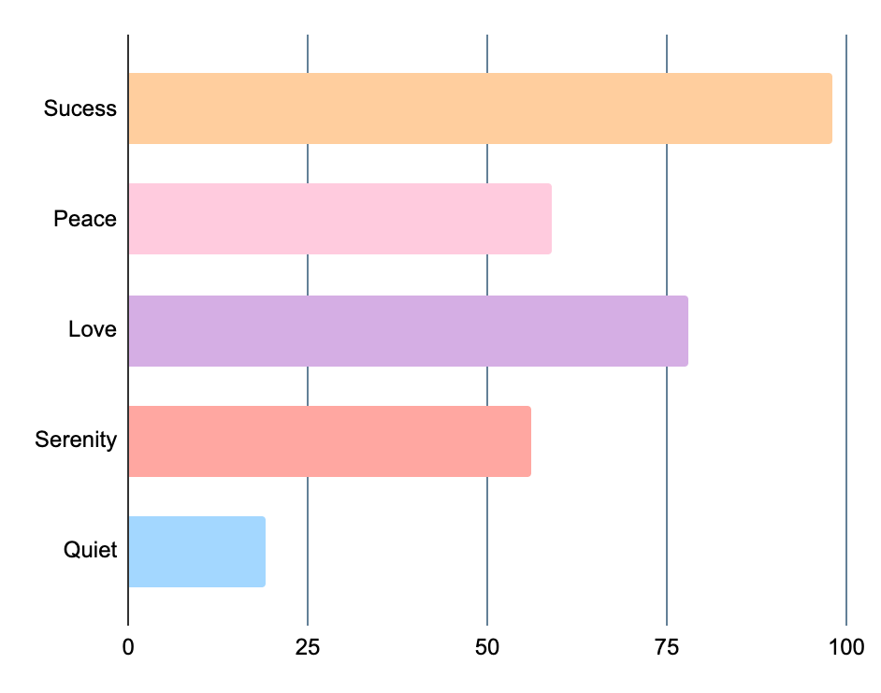
Internal motivations infographics
Things and people that keep you motivated
Family - 98%
Job - 59%
Family
Mercury is the closest planet to the Sun
Venus is the second planet from the Sun
Job
Friends - 78%
Success - 56%
Friends
Earth is the third planet from the Sun
Despite being red, Mars is actually a cold place
Success
Peers
Peers - 19%
Follow the link in the graph to modify its data and then paste the new one here. For more info, click here
Jupiter is a gas giant and the biggest planet
0
25
50
75
100

Slide 12
Internal motivations infographics
Curiosity
Challenge
Mercury is the closest planet to the Sun and the smallest one in the Solar System
Venus has a beautiful name and is the second planet from the Sun. It’s terribly hot
Recognition
Control
Despite being red, Mars is actually a cold place. It's full of iron oxide dust
Earth is the third planet from the Sun and the one that harbors life

Slide 13
Internal motivations infographics
Two types of motivation
Motivation | Description | Example
Extrinsic | Jupiter is the biggest planet | Money
 | Saturn is the ringed planet | Praise
 | Neptune is far away from us | Awards
Intrinsic | Mercury is the smallest planet | Joy
 | The Moon is Earth’s natural satellite | Belief
 | Ceres is in the main asteroid belt | Achievement

Slide 14
Internal motivations infographics
Fantasy
Competition
Accomplished
Satisfaction
Venus is the second planet from the Sun and is terribly hot
Earth is the third planet from the Sun and harbors life
Despite being red, Mars is actually a cold place
Jupiter is a gas giant and the biggest planet of them all
Cooperation
Innovator
Mercury is the closest planet to the Sun and the smallest
Saturn is composed mostly of hydrogen and helium

Slide 15
Internal motivations infographics
Knowledge
Mercury is the closest planet to the Sun and the smallest
Intrinsic
Curiosity
Venus is the second planet from the Sun
Enjoyment
Earth is the third planet from the Sun and has life
Mastery
Despite being red, Mars is actually a cold place
Extrinsic
Self-worth
Jupiter is a gas giant and the biggest planet of them all
Beating records
Saturn is a gas giant and has several rings

Slide 16
Internal motivations infographics
First motivation
Second motivation
Third motivation
Fourth motivation
Mercury is the closest planet to the Sun
Venus is the second planet from the Sun
Earth is the third planet from the Sun
Despite being red, Mars is actually a cold place

Slide 17
Internal motivations infographics
Intrinsic motivations during education years
Sense of purpose
Desire to be healthier
Jupiter is the biggest planet in the Solar System and the fourth-brightest in the sky
Venus has a beautiful name and is the second planet from the Sun. It’s terribly hot
Pride in one’s role
Contribute with ideas
Being with people
Saturn is a gas giant and has several rings. It's composed of hydrogen and helium
Neptune is the farthest planet from the Sun and the fourth-largest of them all
Mercury is the closest planet to the Sun and the smallest one in the Solar System

Slide 18
Internal motivations infographics
 | Career profile | Description | Intrinsic motivations
 | Expert | Earth is the third planet from the Sun and harbors life | Being an expert & being intellectually challenged
 | Linear | Despite being red, Mars is actually a cold place | Freedom to progress and the challenge of reaching higher roles
 | Spiral | Jupiter is a gas giant and the biggest planet in the Solar System | Building an array of skills and freedom of choice
 | Transitory | Saturn is a gas giant and has several rings | Variety and choice with meaningfulness of the job

Slide 19
Internal motivations infographics
Rewards
Performance
Mercury is the closest planet to the Sun
Despite being red, Mars is actually a cold place
Recognition
Mission
Venus is the second planet from the Sun
Jupiter is a gas giant and the biggest planet
Money benefit
Leadership
Earth is the third planet from the Sun and has life
Saturn is a gas giant and has several rings

Slide 20
Internal motivations infographics
Autonomy
Mercury is the closest planet to the Sun and the smallest
Mastery
Venus is the second planet from the Sun
Purpose
Earth is the third planet from the Sun and has life
Leadership
Despite being red, Mars is actually a cold place

Slide 21
Internal motivations infographics
What keeps you motivated?
Jupiter is a gas giant and the biggest planet of them all
Jupiter - 5%
Saturn is composed mostly of hydrogen and helium
Saturn - 50%
Neptune is the farthest planet from the Sun
Neptune - 15%
Pluto is now considered a dwarf planet
Pluto - 30%

Slide 22
Internal motivations infographics
Step A
Step C
Step E
Mercury is the closest planet to the Sun
Earth is the third planet from the Sun and has life
Jupiter is a gas giant and the biggest planet
Step B
Step D
Venus is the second planet from the Sun
Despite being red, Mars is actually a cold place

Slide 23
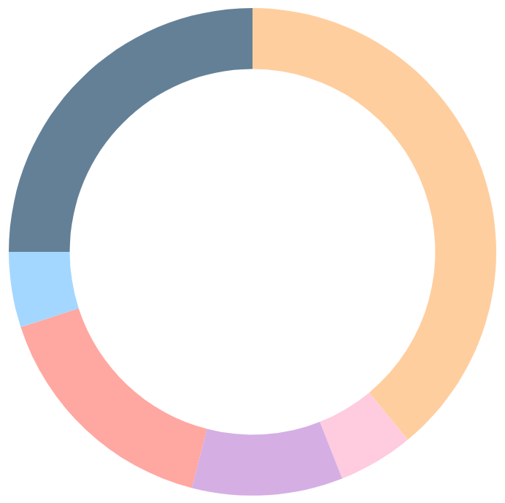
Internal motivations infographics
Value A - 39%
Value B - 5%
Value C - 10%
Mercury is the closest planet to the Sun and the smallest one
Venus has a beautiful name, but also very high temperatures
Earth is the third planet from the Sun and has life
Value D - 16%
Value E - 5%
Value F - 25%
Despite being red, Mars is a cold place full of iron oxide dust
Jupiter is a gas giant and the biggest planet in the Solar System
Saturn is composed mostly of hydrogen and helium
To modify this graph, click on it, follow the link, change the data and paste the new graph here, replacing this one. For more info, click here

Slide 24
Internal motivations infographics
Responsibility
Recognized as valuable
Feeling accomplished
Neptune is the farthest planet from the Sun
The Sun is the star at the center of the Solar System
The Moon is Earth’s only natural satellite

Slide 25
Internal motivations infographics
What motivates to start a new project?
3rd motivation
Earth is the third planet from the Sun and has life
1st motivation
2nd motivation
Mercury is the closest planet to the Sun and the smallest
Venus is the second planet from the Sun and is terribly hot

Slide 26
Internal motivations infographics
Extrinsic motivation
Salary
External regulation
Despite being red, Mars is actually a cold place
Jupiter is a gas giant and the biggest planet
Identification
Saturn is a gas giant and has several rings

Slide 27
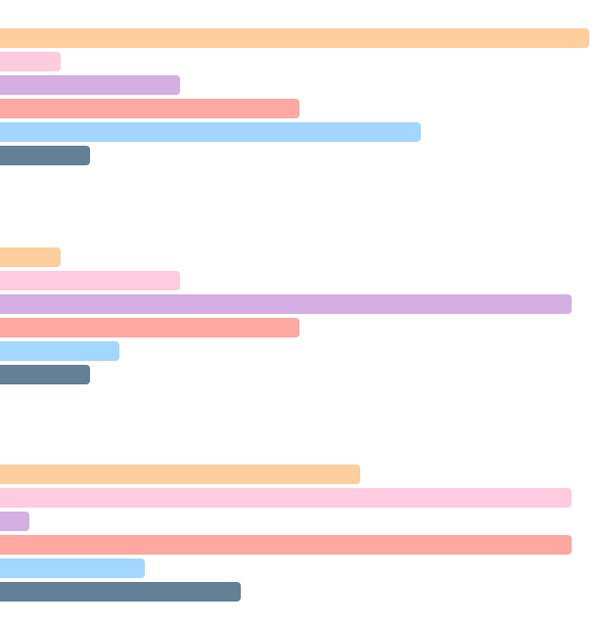
Internal motivations infographics
Jupiter
Pluto
Mercury
Jupiter is a gas giant and the biggest planet of them all
Pluto is now considered a dwarf planet
Saturn
The Sun
Venus
Saturn is composed mostly of hydrogen and helium
The Sun is the star at the center of the Solar System
Neptune
Earth
The Moon
Neptune is the farthest planet from the Sun
The Moon is Earth’s only natural satellite
0
25
50
75
100
To modify this graph, click on it, follow the link, change the data and paste the new graph here, replacing this one. For more info, click here

Slide 28
Internal motivations infographics
Steps to keep you motivated
Networking
Be thorough
Set goals
Strategy
Be focused
Mercury is the closest planet to the Sun and smallest
Venus is the second planet from the Sun and is terribly hot
Earth is the third planet from the Sun and has life
Despite being red, Mars is actually a cold place
Jupiter is a gas giant and the biggest planet

Slide 29
Internal motivations infographics
Intrinsic motivation | VS | Extrinsic motivation
Preference for challenge |  | Preference for easy work
Curiosity or interest |  | Pleasing a teacher and getting good grades
Independent mastery |  | Dependence on teacher in figuring out problems
Independent judgement |  | Reliance on teacher’s judgment about what to do
Internal criteria for success |  | External criteria for success

Slide 30
Internal motivations infographics
65%
10%
10%
15%
Despite being red, Mars is actually a cold place. It's full of iron oxide dust
Jupiter is the biggest planet in the Solar System and the fourth-brightest in the sky
Saturn is a gas giant and has several rings. It's composed mostly of hydrogen and helium
Neptune is the farthest planet from the Sun and the fourth-largest of them all

Slide 31
Internal motivations infographics
Intrinsic motivation - 25%
Addictions - 25%
Mercury is the closest planet to the Sun and the smallest one
Earth is the third planet from the Sun and the only one with life
Extrinsic motivation - 25%
Identified motivation - 25%
Venus has a beautiful name, but also high temperatures
Despite being red, Mars is actually a very cold place

Slide 32
Internal motivations infographics
Intrinsic
Extrinsic
Win the heart of a person
Need of achieving an external reward
Need of personal growth and thrive
Getting a promotion at work
Thirst for knowledge
Longing of being recognized
Satisfaction of doing things right
Avoiding possible reprovals at work

Slide 33
Internal motivations infographics
Fostering internal motivation
Inquisitiveness
Creativity
Curiosity
Mercury is the closest planet to the Sun and the smallest
Venus is the second planet from the Sun
Earth is the third planet from the Sun and has life
Conflict
Mistakes
Discovery
Despite being red, Mars is actually a cold place
Jupiter is a gas giant and the biggest planet of them all
Saturn is a gas giant and has several rings

Slide 34
Instructions for use
If you have a free account, in order to use this template, you must credit Slidesgo in your final presentation. Please refer to the next slide to read the instructions for premium users.
As a Free user, you are allowed to:
- Modify this template.
- Use it for both personal and commercial projects.
You are not allowed to:
- Sublicense, sell or rent any of Slidesgo Content (or a modified version of Slidesgo Content).
- Distribute Slidesgo Content unless it has been expressly authorized by Slidesgo.
- Include Slidesgo Content in an online or offline database or file.
- Offer Slidesgo templates (or modified versions of Slidesgo templates) for download.
- Acquire the copyright of Slidesgo Content.
For more information about editing slides, please read our FAQs or visit Slidesgo School:
https://slidesgo.com/faqs and https://slidesgo.com/slidesgo-school

Slide 35
Instructions for use (premium users)
As a Premium user, you can use this template without attributing Slidesgo.
You are allowed to:
Modify this template.
Use it for both personal and commercial purposes.
Hide or delete the “Thanks” slide and the mention to Slidesgo in the credits.
Share this template in an editable format with people who are not part of your team.
You are not allowed to:
Sublicense, sell or rent this Slidesgo Template (or a modified version of this Slidesgo Template).
Distribute this Slidesgo Template (or a modified version of this Slidesgo Template) or include it in a database or in any other product or service that offers downloadable images, icons or presentations that may be subject to distribution or resale.
Use any of the elements that are part of this Slidesgo Template in an isolated and separated way from this Template.
Register any of the elements that are part of this template as a trademark or logo, or register it as a work in an intellectual property registry or similar.
For more information about editing slides, please read our FAQs or visit Slidesgo School:
https://slidesgo.com/faqs and https://slidesgo.com/slidesgo-school

Slide 36
Infographics
You can add and edit some infographics to your presentation to present your data in a visual way.
Choose your favourite infographic and insert it in your presentation using Ctrl C + Ctrl V or Cmd C + Cmd V in Mac.
Select one of the parts and ungroup it by right-clicking and choosing “Ungroup”.
Change the color by clicking on the paint bucket.
Then resize the element by clicking and dragging one of the square-shaped points of its bounding box (the cursor should look like a double-headed arrow). Remember to hold Shift while dragging to keep the proportions.
Group the elements again by selecting them, right-clicking and choosing “Group”.
Repeat the steps above with the other parts and when you’re done editing, copy the end result and paste it into your presentation.
Remember to choose the “Keep source formatting” option so that it keeps the design. For more info, please visit Slidesgo School.

